Slide 1
WELCOME TO DEBATE!
WHAT IS DEBATE?

Slide 2
Why debate
When debating, teams explore arguments for and against a specific proposition
Debating can be an effective and practical learning tool
Debating allows several different qualities to emerge, including
    collecting and organizing ideas,
    critical thinking and evaluating ideas,
    seeing logical connections between ideas,
    adapting to new situations quickly and efficiently, and
    improved writing,
    speaking persuasively.

Slide 3
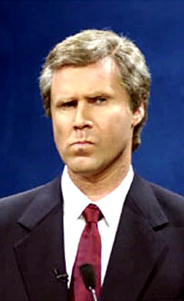
Debate
You may have seen debates on TV where people shouted, ignored counter arguments, or seemed to be in a contest about who could attack the other person more effectively.
STRATEGERY?

Slide 4
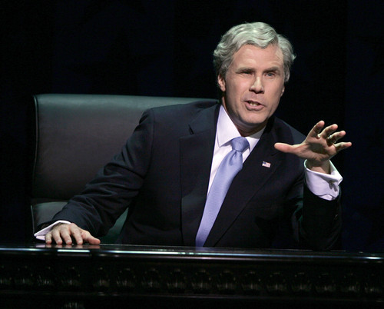
Debate
In a debate, students use a combination of logic, research, strategy, and persuasiveness to appeal to judges who are focused on substantive issues.
SUBSTANTIATION?

Slide 5
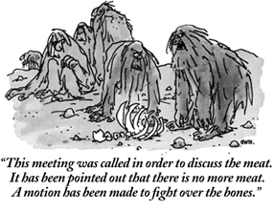
Debate Is:
Structured Argumentation supported with evidence. Time limits force speakers to be efficient and prevent interruptions. Academic debate supports critical, in-depth analysis of the many issues surrounding a topic.

Slide 6
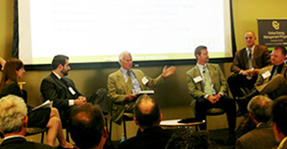
Types of Debate
Policy Debate: teams of two advocate for and against a resolution that typically calls for policy change.

Slide 7
Characteristics:
Evidence based
Cost/benefit analysis
Application/extension
PLAN focused
Real world view
Like a government-based policy adoption should be.

Slide 8
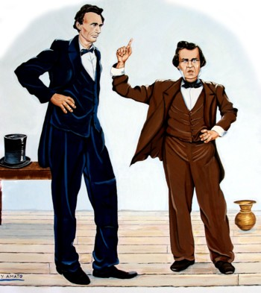
Lincoln-Douglas Debate
two students debate each other in a format that emphasizes values rather than implementation of a plan.

Slide 9
Characteristics
Less evidence based
More philosophical
Ethics/morals based
More delivery oriented
Pre-policy level implications

Slide 10
Which type of debate should I have my students do?
Determine your goals
  Time
  Type of involvement (school program v. Classroom activity)
  Competition level
Evaluate your students
  Numbers
  Work ethics
How many of you are there?

Slide 11
How do I teach debate?!
Explicitly teach vocabulary. Words to begin with: debate, policy debate, LD debate, resolution, affirmative, negative, argument, evidence, refutation.
Get students practicing the skills as soon and as much as possible.
Teach format.
Begin research.
Continue skills practice, integrating format and research.

Slide 12
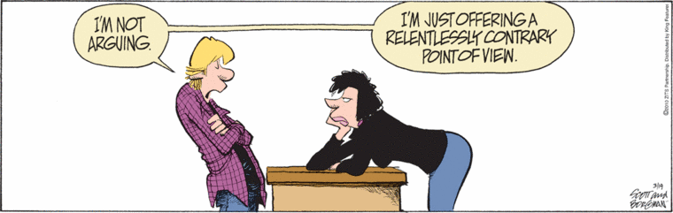
Argument/Claim
A reason given in proof or rebuttal.

Slide 13
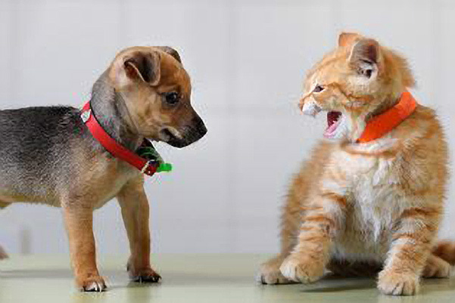
Let’s practice
Write 3 arguments for the resolution:
“Dogs are better than cats.”
They are smarter.
Protect your home.
They don’t hiss.

Slide 14
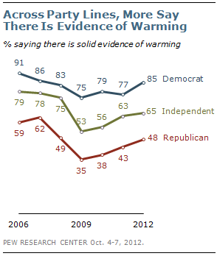
Evidence
Facts, statistics, and expert testimony given in support of an argument.

Slide 15

Let’s practice
Give a piece of evidence to prove our first argument that cats are better than dogs.
Dogs are smarter than cats.
1. Studies show dogs better at solving problems.
Shultz, S., & Dunbar, R. (2010). “Encephalization is Not a Universal Macroevolutionary Phenomenon in Mammals But is Associated with Sociality.” Proceedings of the National Academy of Sciences, 2010.

Slide 16
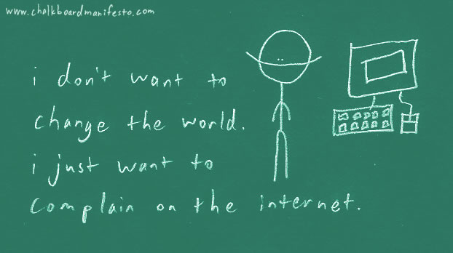
Resolution
The formal statement of the issue to be debated. The topic.

Slide 17

The yearly topic, called the “resolution” is a statement of why someone, usually the government, ought to address a pressing problem.

Slide 18
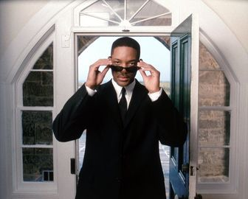

Resolution
Parts of:
  Agent of action—WHO needs to do something.
Generally in academic debate, the agent is a government entity.

Slide 19
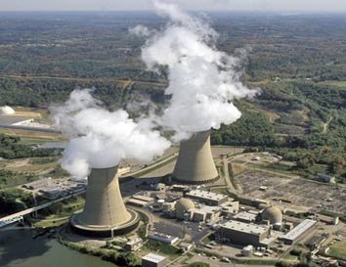

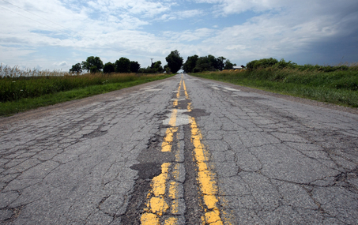
Resolutions
Parts of:
  Topic area

Slide 20
Resolution
Parts of:
  Directionality—how the topic area should be changed.
  ⬆ ⬇ ➔⬅

Slide 21
2012-2013’s Policy resolution is
“Resolved: That the State of Utah substantially increase its support of nuclear electrical generation within its borders.”

Slide 22
2012-2013’s Lincoln-Douglas resolution is
“Resolved: In the State of Utah, increased support and use of nuclear electrical generation is more desirable than relying only on existing methods of electrical generation.”

Slide 23
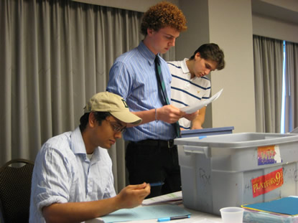
Resolution
Cool GINGER FRO
In every policy debate, two students propose a specific plan to enact the resolution and their two opponents argue that their plan is a bad idea.

Slide 24
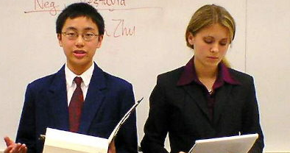
Resolution
In every Lincoln-Douglas debate, each debater supports a side of the resolution. The affirmative supports the resolution, the negative negates the resolution.

Slide 25
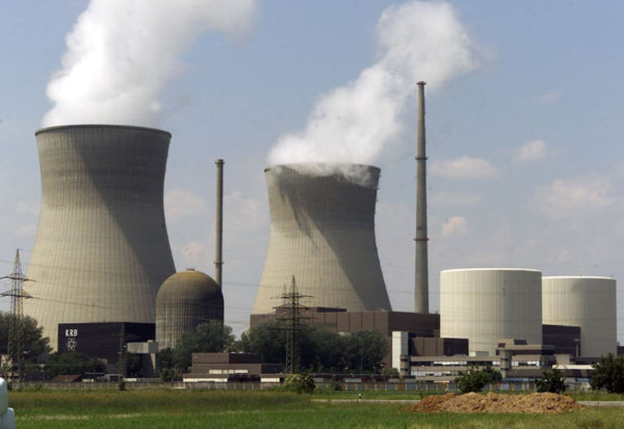
Resolution
Can you brainstorm a list of some reasons we would do nuclear energy?
The first one that comes to my mind is less pollution.
What other reasons can you think of?

Slide 26

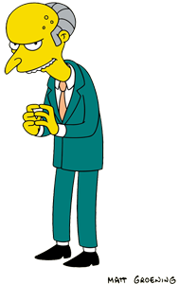
Let’s talk about the resolution:
Nuclear Energy
It’s good because…
What a bad idea…

Slide 27
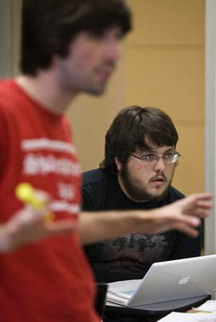
What does a debate look like?
Two students from one school are assigned to be affirmative (they agree with the resolution) and two students from another school are assigned to be negative (they disagree with the resolution).

Slide 28
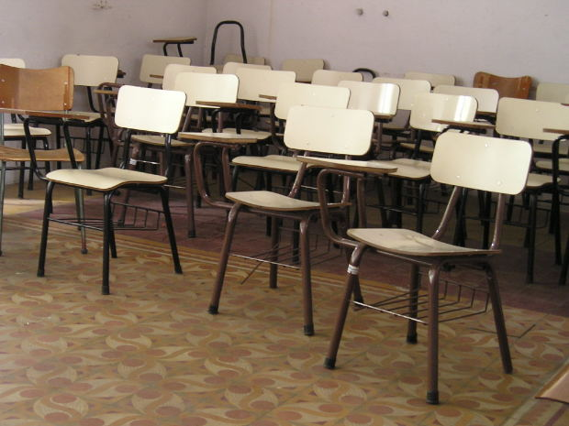
What does a debate look like?
Debates occur in classrooms, in front of one judge and usually no audience.
So, a debate usually consists of just those five people
(less scary than what most people imagine).

Slide 29
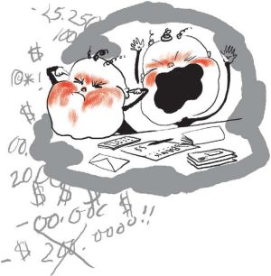
Affirmative vs negative in Policy
The job of the affirmative is to prove that their proposal (which must fit under the resolution) is a good idea.
The job of the negative is
to prove that the affirmative
proposal is either a bad
idea or does not fit under
the resolution.

Slide 30
Affirmative VS Negative in LD
*The job of the affirmative is to prove that their side of the resolution, and its associated values, is good idea. At the same time, they prove their
opponent and the opposite side
of the resolution is a bad idea.
*The job of the negative is
to prove that the their side of
the resolution, and its
associated values, is a good idea.
At the same time, they prove their
opponent and the opposite side
of the resolution is a bad idea.

Slide 31

Affirmative vs negative
Being an eloquent speaker helps but policy debate has much more to do with winning substantive arguments than with oratory.
The judge votes for whichever team does a better job of proving their point.

Slide 32
Affirmative vs negative
You will use a combination of research, logic, and strategic moves to win your debates. Given that you are competing against a very bright pool of students and that debate has a very long learning curve, every debate is different and the game never gets repetitive.

Slide 33

Refutation
The core of debate is refutation. Debaters both make their own points and are responsible for responding to arguments made by the other team. This is what makes debate different from other speaking contests.

Slide 34

Refutation
Write down the following list of arguments and prepare to refute them, point by point:
“Cats are better than dogs because cats are:
1) cleaner,
2) prettier,
3) more lovable.”

Slide 35
Affirmative vs negative
WHAT DID YOU COME UP WITH?

Slide 36
Affirmative vs negative
Let’s try it again but with a political example. Write down this list of arguments again and prepare to refute them.
“George W Bush was the greatest President of all time because 1) he was firm in the war on terror, 2) he liberated the people of Iraq, and 3) he cut taxes.”
Remember! Refute things point by point.
If you have unrelated reasons why he was not the greatest President of all time, save those for the end of your speech (after you have responded to each argument).

Slide 37
Affirmative vs negative
One more time…
“Poverty is a problem that would be better addressed by the government than the free market because: 1) developing countries have very free markets but also the worst poverty while highly regulated economies have lower rates of poverty, 2) the free market cannot demonstrate compassion but government can and we have a moral obligation to alleviate poverty.”
This example is harder. You also learn a TON about the yearly topic from debate.

Slide 38
Affirmative vs negative
ALL debates follow that format. You keep track of what the other team has said by writing it down, you respond to them, and you make your own points that they must respond to.

Slide 39
format for Refutation
"I WIN!"
Step 1: “They say…”
Step 2: “But I disagree…”
Step 3: “Because….”
Try to show that your argument is better because….
    It’s better reasoned
    It’s better evidenced
    It has historical or empirical support
    It has greater significance
Step 4: “Therefore….”

Slide 40
Let’s practice the format…
Respond to each of the following arguments, using the things we’ve learned (Debate, AFF/NEG, Argument, Evidence, Refutation:
  1) McDonald’s is the best restaurant in the world.
  2) Video games should be banned because they make teenagers violent.
  3) Schools should save families money by requiring uniforms.
  4) Nuclear energy is a good idea.

Slide 41
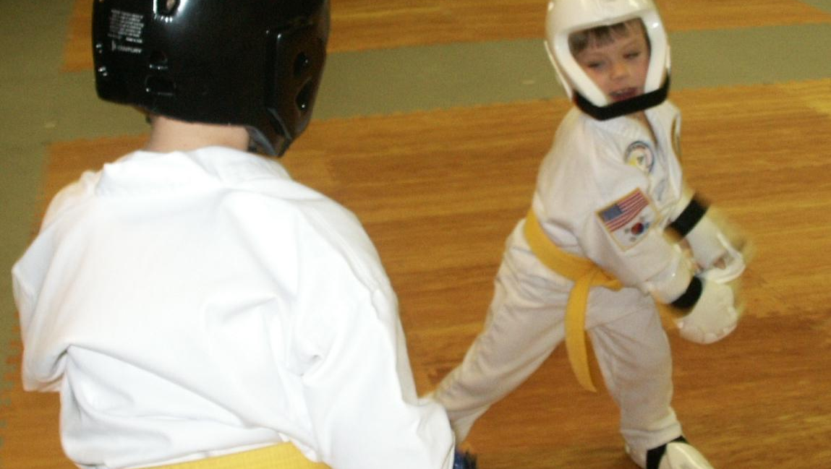
Let’s SPAR!

Slide 42
Format
Affirmative (2 minutes) give three reasons supporting your side of the resolution.
Negative (2 minutes) give three reasons supporting your side of the resolution.
Cross-ex—(3 minutes) ask each other ?’s
Negative—(1 minute) say why you’re right and your opponent is wrong
Affirmative (1 minute) say why you’re right and your opponent is wrong.

